Slide 1
Employee Data Analysis using Excel
STUDENT NAME: A.ISMAIL BASHA
REGISTER NO: NM ID. 298856B4F23010EB9A54CA75FE3B8512/ COLLEGE ID:2213211042013
DEPARTMENT: B.COM(CORPORATE SECRETARYSHIP)
COLLEGE: PRESIDENCY COLLEGE CHENNAI

Slide 2
PROJECT TITLE
Employee Performance Analysis using Excel

Slide 3


AGENDA
Problem Statement
Project Overview
End Users
Our Solution and Proposition
Dataset Description
Modelling Approach
Results and Discussion
Conclusion
3/21/2024 Annual Review

Slide 4

PROBLEM STATEMENT
1.Employee Performance Analysis
2.Recruitment and Selection
3.Compensation and Benefits
4.Retention and Turnover
5.Succession Planning

Slide 5

PROJECT OVERVIEW
1.Project Goal: To utilize Excel's analytical capabilities to extract meaningful insights from employee data, enabling informed decision-making and optimizing HR strategies.
2.Project Scope:
Data collection and preparation: Gathering relevant employee data from various sources and organizing it for analysis.
Data cleaning and validation: Identifying and correcting errors or inconsistencies in the data to ensure accuracy.
Data analysis: Employing Excel functions, formulas, and tools to analyze employee performance, recruitment, compensation, retention, and succession planning.

Slide 6

WHO ARE THE END USERS?
1.HR managers
2.Line managers
3.Employees
4.HR analysts
5.CEO
6.Investors
7.Government agencies

Slide 7

OUR SOLUTION AND ITS VALUE PROPOSITION
Conditional formatting – missing
Filter-remove
Formula - performace
Pivot – summary
Graph – data visualization

Slide 8
Dataset Description
Employee - Kaggle
26- features
9- features
Emp id - num
Name - text
Emp type
Performance level
Gender- male – female
Employee rating - Num

Slide 9
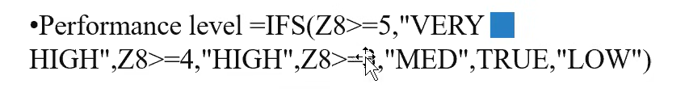

THE "WOW" IN OUR SOLUTION
3/21/2024 Annual Review
9

Slide 10
MODELLING
1.Data collection:
Performance Management System: This system captures performance data, including goals, objectives, ratings, and feedback.
Time and Attendance System: This system tracks employee work hours, absences, and overtime.
Exit Interviews: This data provides insights into reasons for employee
2.Feature collection:
Mean: Average value of a dataset.
Median: Middle value of a dataset.
Mode: Most frequent value in a dataset.
Filtering: Selecting specific data based on criteria.
Sorting: Arranging data in ascending or descending order.
Data Types: Ensuring data is entered in the correct format (e.g., numbers, text, dates).
Input Rules: Setting conditions for valid data entry.
Highlighting: Applying visual cues to data based on specific conditions.
10

Slide 11
MODELLING
3.Data Cleaning:
Gather data: Collect the required data from the identified sources, ensuring that it is accurate, complete, and up-to-date.
Organize data: Structure the data in a way that is easy to analyze, such as creating a spreadsheet or database.
Clean and validate data: Identify and correct any errors or inconsistencies in the data to ensure its accuracy.
4.Performace:
Knowledge of Excel features: Understanding of Excel functions, formulas, and tools.
Data analysis skills: Ability to apply appropriate analysis techniques to answer questions.
Problem-solving abilities: Capacity to break down complex problems and find solutions.
Attention to detail: Ability to ensure data accuracy and consistency.
Communication skills: Ability to effectively communicate findings and recommendations.

Slide 12
MODELLING
5.Summary:
Descriptive statistics: Calculating mean, median, mode, standard deviation, and other summary measures.
Data visualization: Creating charts and graphs to visualize data trends and patterns.
Data filtering and sorting: Selecting and arranging data based on specific criteria.
Data validation: Ensuring data accuracy and consistency.
Conditional formatting: Applying visual cues to highlight data based on conditions.
Formulas and functions: Using built-in formulas to perform calculations and manipulate data.
What-if analysis: Exploring different scenarios and outcomes.
Data analysis tools: Accessing tools for correlation, regression, ANOVA, and hypothesis testing.
Pivot tables and slicers: Summarizing and analyzing data in interactive tables.
Power Query: Transforming and integrating data from various sources.
6.Visualization:
Bar charts
Line Charts
Pie charts
Area charts

Slide 13
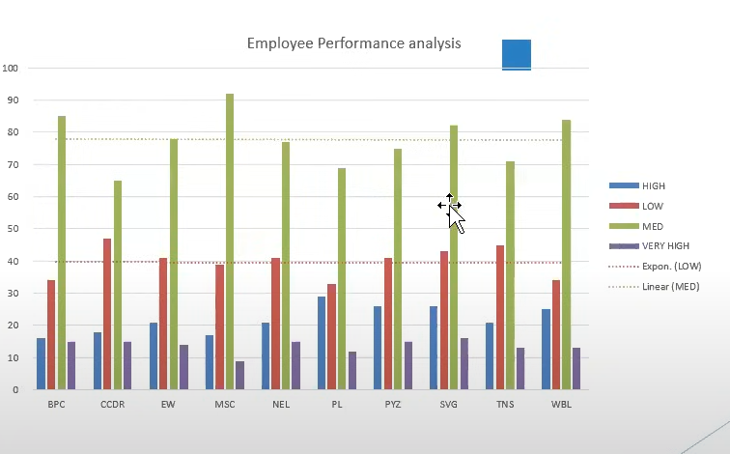
RESULTS
13

Slide 14
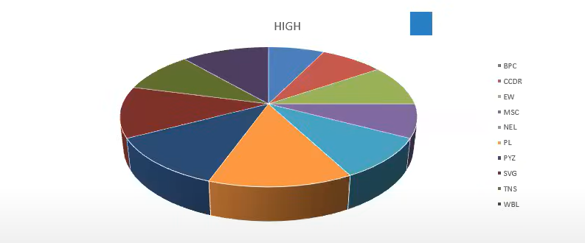
RESULTS

Slide 15
conclusion
Excel is a powerful tool for analyzing employee data and extracting valuable insights. By effectively utilizing Excel's features, organizations can:
Improve employee performance: Identify top performers, assess training effectiveness, and analyze factors influencing engagement.
Optimize recruitment and selection: Evaluate recruitment efficiency, assess candidate qualifications, and identify biases.
Enhance compensation and benefits: Determine fair compensation, analyze incentive programs, and identify pay gaps.
Reduce employee turnover: Understand turnover reasons, identify factors contributing to satisfaction, and develop retention strategies.
Strengthen succession planning: Identify potential successors, assess development needs, and create a succession plan.
Through data-driven analysis, organizations can make informed decisions, optimize HR strategies, and create a more engaged and productive workforce. By leveraging Excel's capabilities, HR professionals can gain a deeper understanding of their employees, identify areas for improvement, and drive positive organizational change.

